Slide 1
Workforce research guide
SE 6387.001
Team: Group2
Shin Yi Lin
Fenil Shah
Ramprasadh Srivathsa
Harshal Pawar
Mark Dwight

Slide 2
Objective and scope
Objective
Help management and HR dept. to organize and correlate beliefs and facts
Correlate documents with facts & beliefs
Reduce the effort/time in manual data management
Scope
A rich GUI for interaction
Ability to add new facts/beliefs to database
Search and view associated facts/ beliefs

Slide 3
Member Responsibilities
Member Name | Roles and Responsibilities
Harshal Pawar | UI development Integration with backend
Shin-Yi Lin | Java backend development Testing use cases
Mark Dwight | UI development Integration with backend
Fenil Shah | Java backend development Database management
Ramprasadh Srivathsa | Java backend development Testing use cases

Slide 4
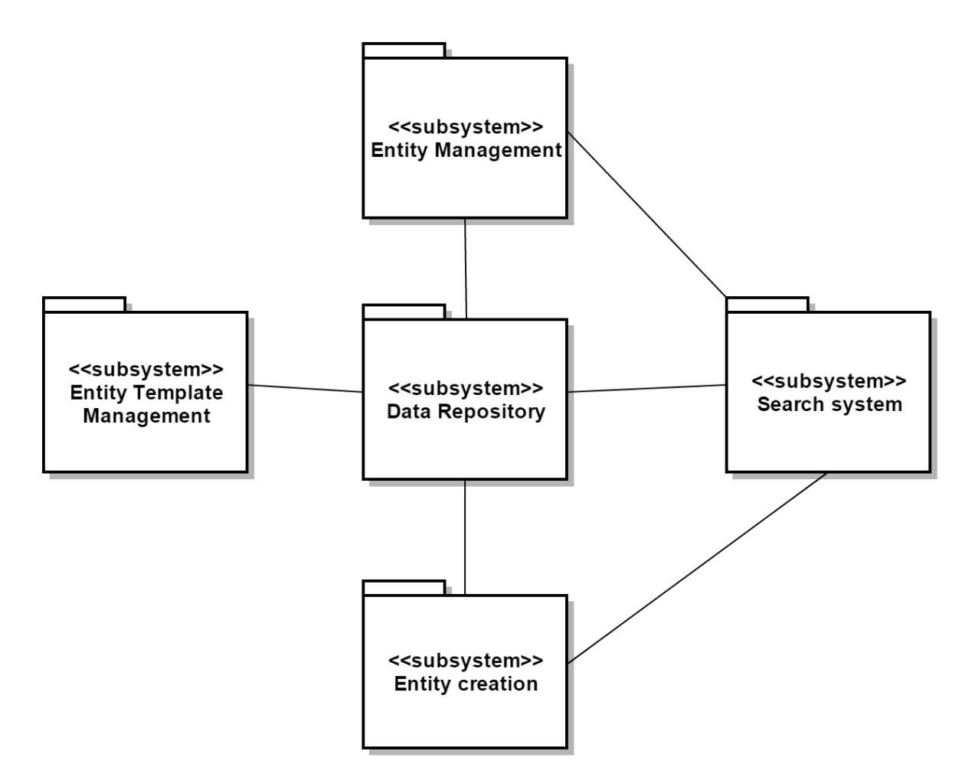
Member Responsibilities

Slide 5
Our Approach
Topic | Rational
Spiral Model Lifecycle | Continuous feedback & comments Prototype and incremental development
UML Diagrams | Capture requirements Software designing
Java | Platform independent / Portable Object-oriented
SQLite Database | Light-weight DBMS Run on personal desktop of HR people
GitHub (git) | Source code management Version control
Junit | Unit testing

Slide 6
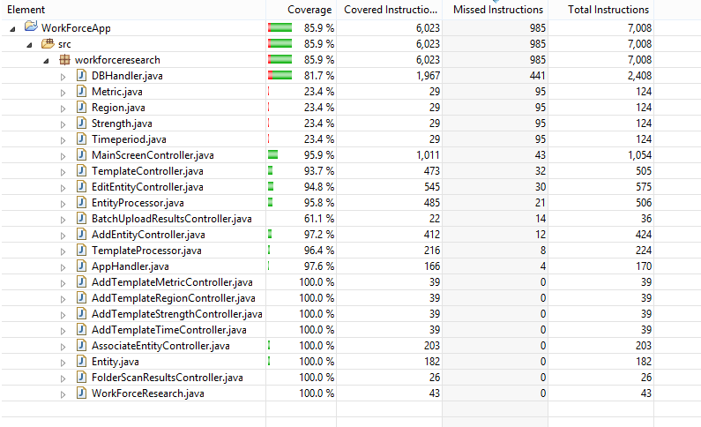
Test Results

Slide 7
Final Deliverables
Project Report
Project source code on GitHub
Executable(.exe/.jar) file of system

Slide 8
Lessons Learned
Pros
Understanding importance of clarity of requirements
Importance of a well defined scope
Team communication and coordination
Getting constant feedbacks
Self learning – GIT, JavaFX, SQLite etc.
Cons
Should have kept buffer time before deadline considering Exam schedule
Set GIT master branch earlier to avoid version/code conflicts

Slide 9
Comments/suggestions
Helped us grow leadership skills by providing autonomy
Excellent feedback from Jeff
Belief and trust shown by Prof. Wong that we would meet project requirements

Slide 10
Questions ?

Slide 11
Thank You!!!

